Slide 1
DRUG RECOMMENDATION SYSTEM BASED ON SENTIMENT ANALYSIS OF DRUG REVIEWS USING MACHINE LEARNING
PRESENTED BY
A.AMULYA (20J21A0501)
A.SAI KIRAN (20J21A0503)
K.CHANDRA SIDDARTHA(20J21A0531)
K.SAI MANU(20J21A0537)
GUIDED BY
DR.T.PRABAKARAN
Professor , HOD
Department of CSE

Slide 2
TITLE JUSTIFICATION
The "Drug Recommendation System Based on Sentiment Analysis of Drug Reviews Using Machine Learning" title aptly captures a novel approach to improving healthcare decision-making.
By employing machine learning and sentiment analysis, this system aims to harness the collective patient sentiment from drug reviews, enabling personalized medication recommendations.
This innovative method not only optimizes patient treatment but also empowers medical practitioners with data-driven insights, reducing the risk of medical errors.
The integration of sentiment analysis and machine learning showcases a transformative step towards informed and safer healthcare choices, aligning with the evolving landscape of technology-driven medical solutions.

Slide 3
ABSTRACT
Healthcare Information Accessibility: Accessing reliable health-related information online can be challenging due to information dispersion and potential harmful content.
Importance of Recommendation Systems: The abundance of clinical information spread across the internet makes finding useful data for health improvement difficult.
Project Objective: It employs patient reviews to predict sentiment using techniques like Bag of Words (BOW), TF-IDF(Term Frequency Inverse Document Frequency), Word2Vec, and Manual Feature Analysis.
Evaluation of Results: The success of the recommendation system is evaluated through precision, recall, F1 score, accuracy, and AUC score.

Slide 4
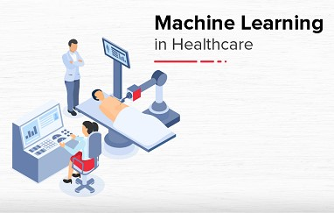
INTRODUCTION TO DOMAIN
Definition: Machine learning is a subset of artificial intelligence (AI) that enables computers to learn and improve performance without explicit programming.
Predictions and Decisions: Machine learning allows systems to make predictions or decisions based on data patterns.
Techniques: Machine learning includes various techniques such as supervised learning, unsupervised learning, and reinforcement learning.
Applications: Machine learning is widely used across industries like healthcare, finance, and technology to automate processes, make predictions, and uncover insights.

Slide 5
EXISTING SYSTEM
Medical Errors : Despite growing health consciousness, a significant number of people still suffer and even die due to medical errors, often stemming from incorrect medication.
Potential of Advanced Technologies: Emerging technologies such as machine learning, deep learning, and data mining offer promising solutions.
Reducing Medical Errors: By utilizing these technologies, healthcare professionals can access personalized insights, making it possible to reduce medical errors and improve patient care.
Doctor-Friendly Approach: Implementing these technologies in a doctor-friendly manner can empower medical professionals with data-driven insights, ultimately leading to more informed and accurate treatment decisions.

Slide 6
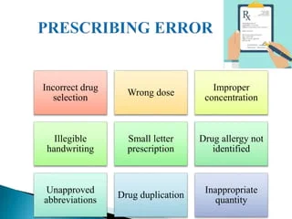
EXISTING SYSTEM DISADVANTAGES
Limited Doctor Experience: The heavy reliance on machine learning might discourage doctors from relying on their clinical judgment
Overemphasis on Technology: Excessive dependence on emerging technologies could lead to a neglect of the human aspect of healthcare.
Data Privacy Concerns: Mishandling or breaches of this sensitive information could have severe consequences.
Initial Implementation Challenges:The integration of these technologies into the healthcare system may face resistance.

Slide 7
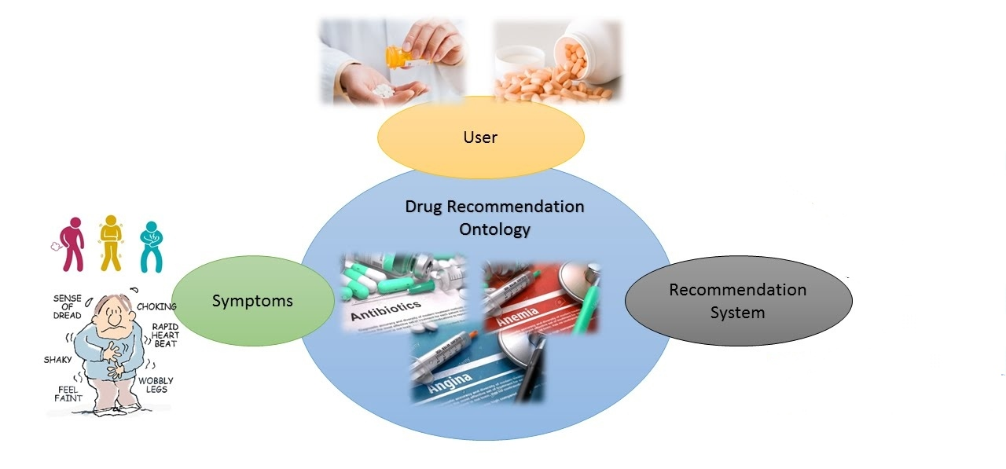

PROPOSED SYSTEM
Purpose of Recommender
Application in Drug Recommendations
Sentiment Analysis
Enhancing Model Performance

Slide 8

PROPOSED SYSTEM ADVANTAGES
Personalized Recommendations: Suggestions to users based on their interests and needs, enhancing the user experience by providing relevant content.
Utilization of Customer Feedback: These systems leverage customer reviews to analyze sentiment from user opinions and attitudes.
Optimized Drug Recommendations: Patients benefit from personalized medication suggestions for specific medical conditions, increasing the likelihood of effective treatment.
Enhanced Decision-Making: Sentiment analysis tools assist in understanding user preferences and sentiments about medications and healthcare.

Slide 9

SOFTWARE AND HARDWARE REQUIREMENTS
Programming Languages: You will need programming languages such as Python or R, which are popular for machine learning tasks.
Machine Learning Libraries and Frameworks: You will need to install and configure machine learning libraries and frameworks that are relevant to your project.
Storage: Depending on the size of your dataset, you'll need sufficient storage capacity.
CPU,GPU : For training deep learning models, especially large neural networks, we use CPUs with more cores or even GPUs for accelerated training.
RAM (Memory): Having an ample amount of RAM is crucial for handling large datasets and complex machine learning models.

Slide 10
MODULES EXPLANATION
Data preprocessing: involves cleaning drug reviews by removing HTML tags, non-alphabetic characters, and stopwords. Sentiments are labeled based on ratings, enabling effective machine learning analysis for drug recommendations.
Data Processing: Utilize Natural Language Processing (NLP) to clean and preprocess drug reviews, extracting sentiments and converting text into meaningful features.
Model Building: Implement machine learning classifiers, such as Naive Bayes, to analyze sentiments and predict positive, neutral, or negative labels for drug reviews.
Evaluation Metrics: Assess model performance using metrics like accuracy, precision, recall, and F1-score, ensuring reliable sentiment analysis and effective drug recommendations.
User Interaction : Enable user interaction through a user-friendly interface, allowing individuals to input reviews and receive personalized drug recommendations based on sentiment analysis results.

Slide 11
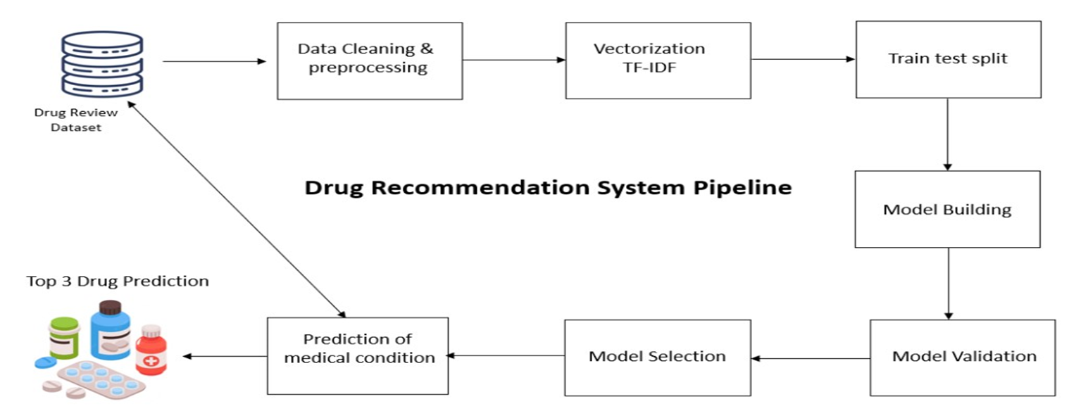
ARCHITECTURE

Slide 12
ALGORITHM EXPLANATION
Logistic Regression: It is applied to identify the new recommendation whether this dataset is valid or not. First it uses fit() function to fit the model on train dataset After that uses predict() function ,if classification rate is 80% it is as considered as good accuracy.
Collaborative Filtering:
User-based Collaborative Filtering: It calculates the similarity between users and suggests drugs that similar users have found effective or suitable.
Item-based Collaborative Filtering: It recommends drugs similar to those the user has previously interacted with.
Content-Based Filtering: It always recommends drugs based on the features and characteristics of the drugs themselves and the user’s historical preferences. Features includes drug class, indications, side effects.
Linear SVC (Support Vector Classifier) is a linear classification algorithm that separates data points using a hyperplane for binary classification.
Decision tree: a hierarchical model that makes decisions by recursively splitting data based on features, forming a tree-like structure.

Slide 13
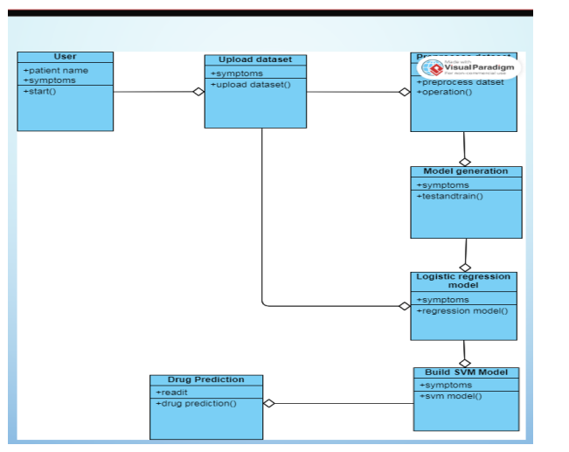
UML DIAGRAMS
FIG:CLASS DIAGRAM

Slide 14
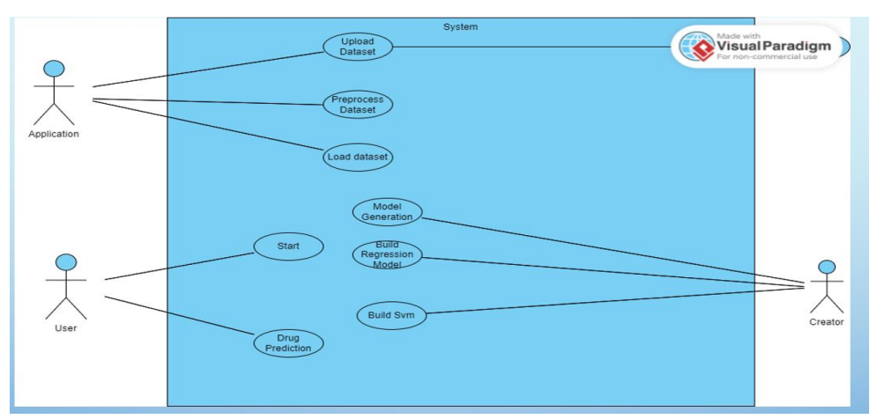
FIG:USECASE DIAGRAM

Slide 15
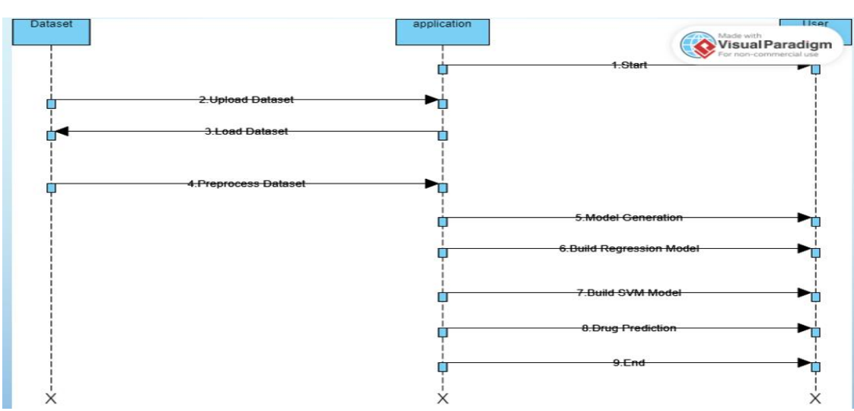
FIG:SEQUENCE DIAGRAM

Slide 16
TESTING
Accessibility Testing: Ensure apps are usable for users with disabilities; crucial for functional and inclusive design.
Acceptance Testing: Client-coordinated testing to validate compliance with utility regulations; successful tests with no issues found.
Black Box Testing: Evaluate product without knowledge of internal workings; tests include field operations, page launches, and performance criteria.
End-to-End Testing: Assess each stage of application workflow to ensure seamless functionality across the entire process.
White Box Testing: Tester aware of internal workings; used to validate accessibility and identify inaccessible areas.

Slide 17
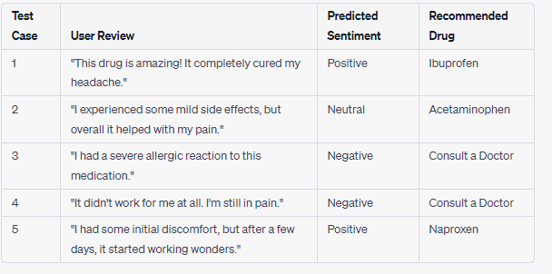
TEST CASES

Slide 18
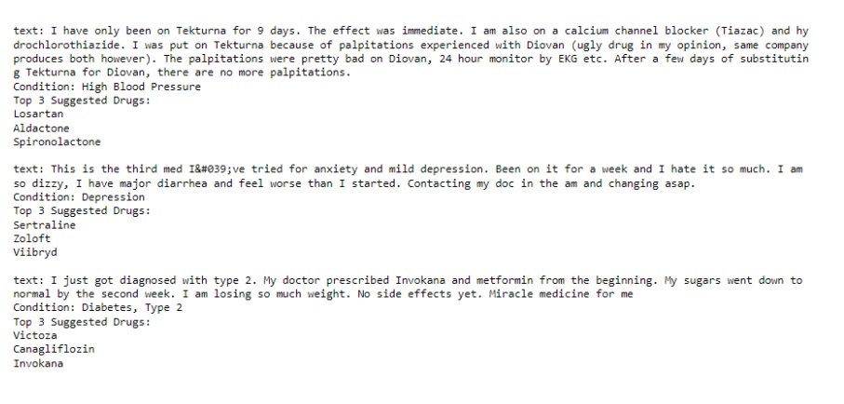
OUTPUT

Slide 19
CONCLUSION
Motivation for Research: Reviews crucial for decisions in shopping, online purchases, and dining; inspiring sentiment analysis of drug reviews for a recommender system.
Classifier Performance: Linear SVC on TF-IDF outperforms others (93% accuracy); Decision Tree on Word2Vec performs poorly (78% accuracy).
Emotion Integration: Emotion values integrated (e.g., Linear SVC on TF-IDF - 93%) to calculate normalized useful count, contributing to drug recommendation scores.
Future Work: Planned future work involves exploring oversampling techniques, varying n-grams, and optimizing algorithms to enhance recommender system performance.

Slide 20
THANK YOU

